Slide 1
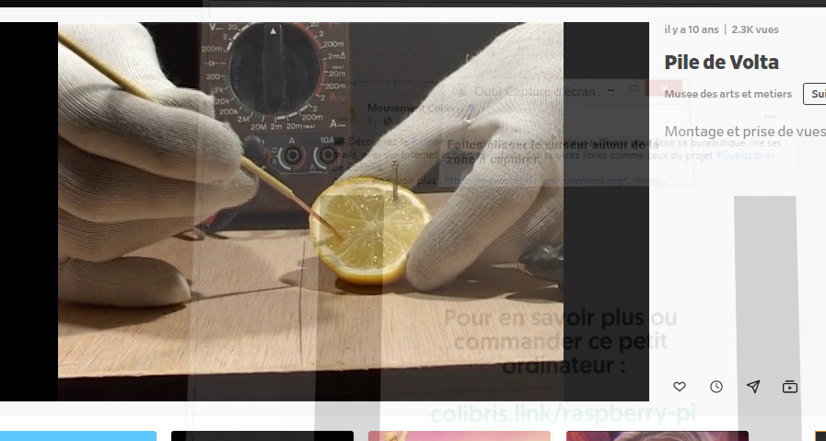
https://www.dailymotion.com/video/xg1sdv

Slide 2
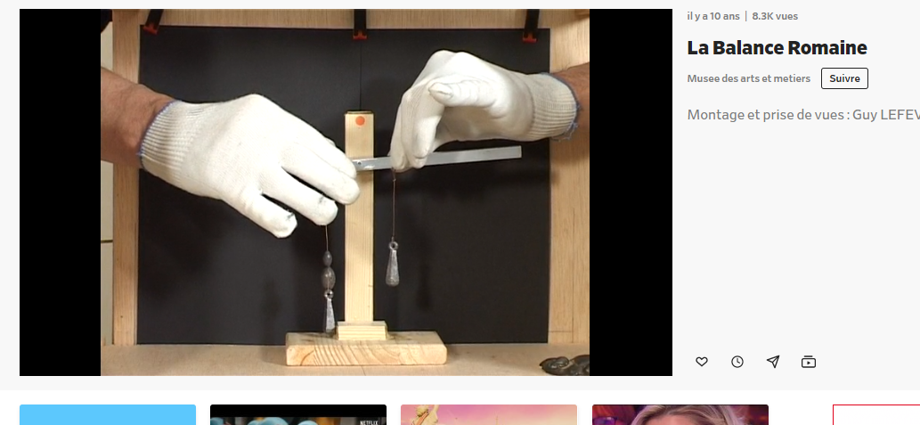
https://www.dailymotion.com/video/xg1saz

Slide 3
https://www.dailymotion.com/video/xg1sa0

Slide 4
https://www.dailymotion.com/video/xfzx

Slide 5
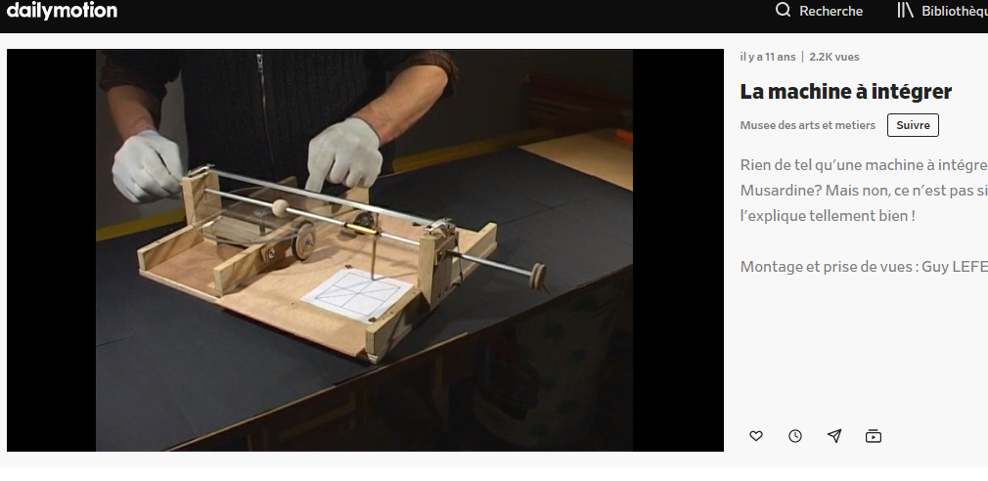
https://www.dailymotion.com/video/xd6kd5

Slide 6
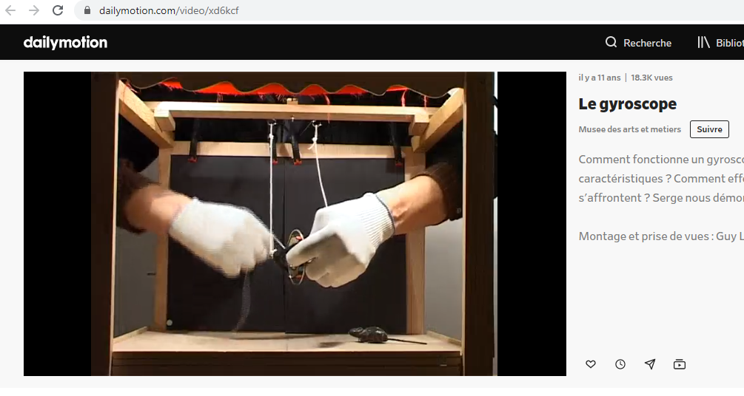
https://www.dailymotion.com/video/xd6kcf

Slide 7
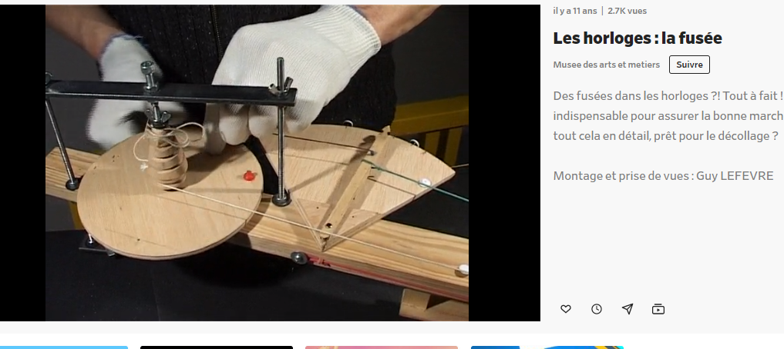
https://www.dailymotion.com/video/xd6kaw

Slide 8
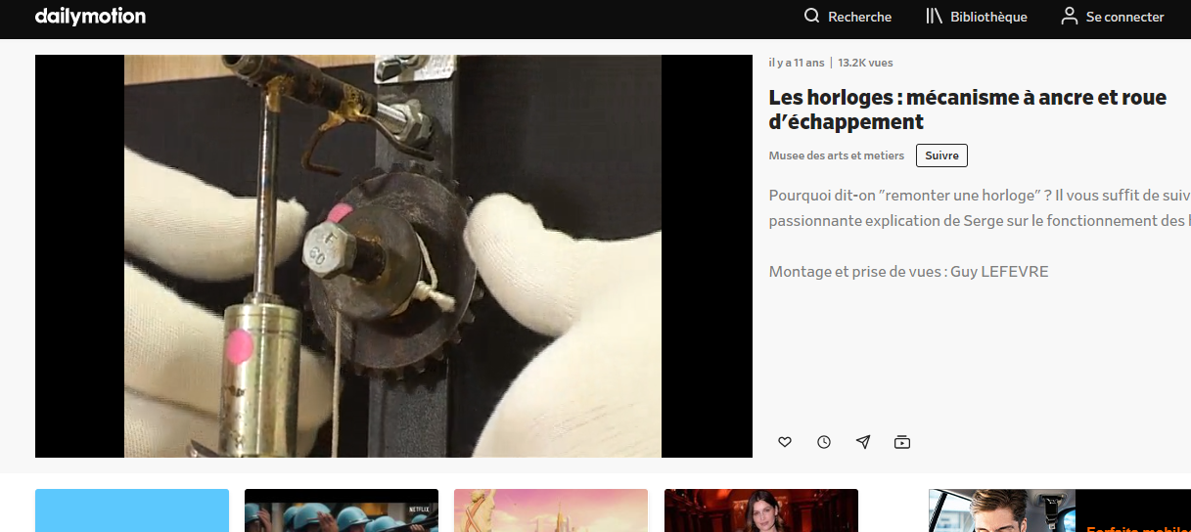
https://www.dailymotion.com/video/xd6k8d

Slide 9
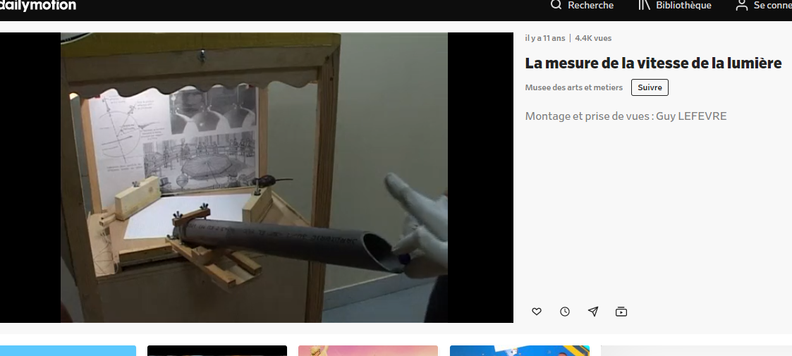
https://www.dailymotion.com/video/xd6k7k

Slide 10
https://www.dailymotion.com/video/xd6k6t

Slide 11
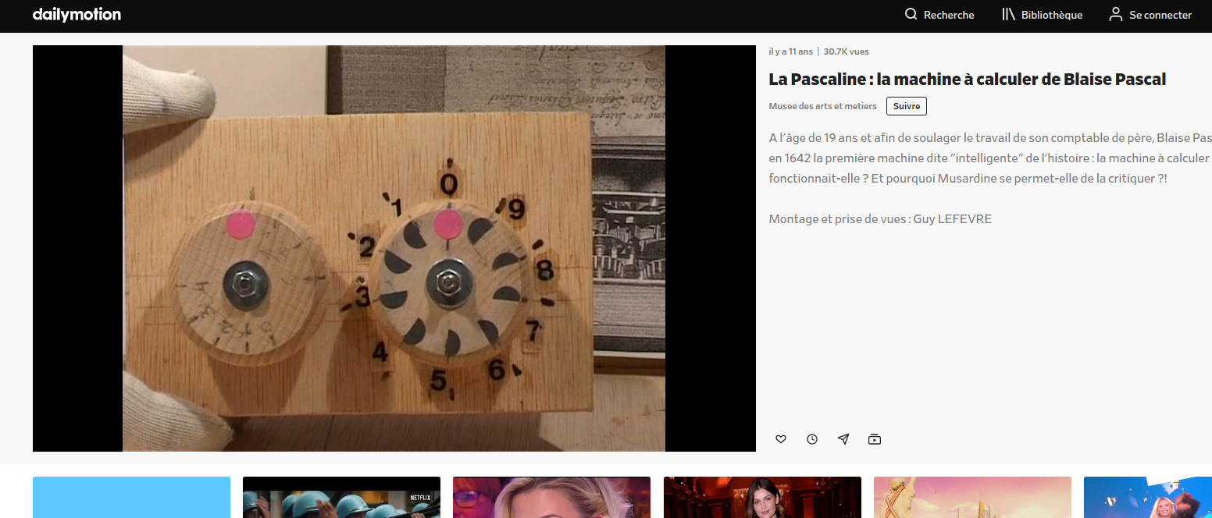
https://www.dailymotion.com/video/xd6k4j

Slide 12
https://www.dailymotion.com/video/xbvax5

Slide 13
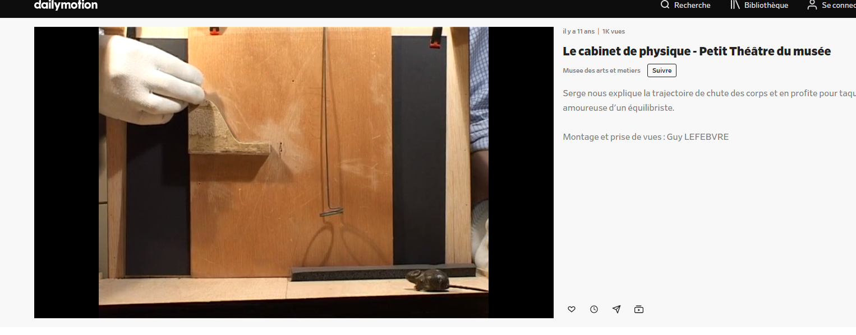
https://www.dailymotion.com/video/xbvavi

Slide 14
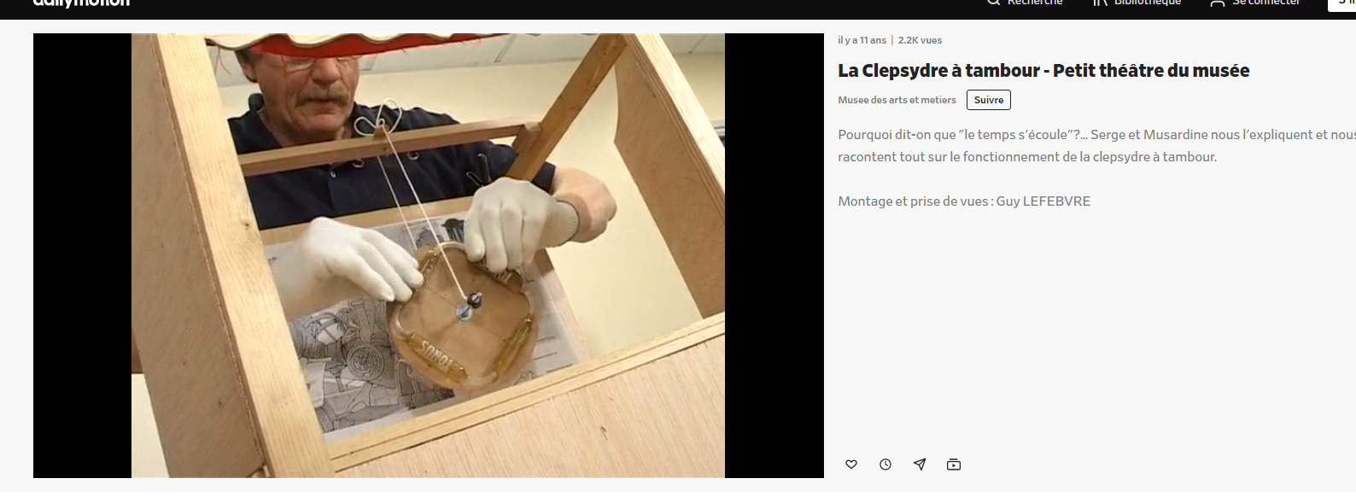
https://www.dailymotion.com/video/xbv7cy

Slide 15
https://www.dailymotion.com/video/xd6ka0

