Slide 1
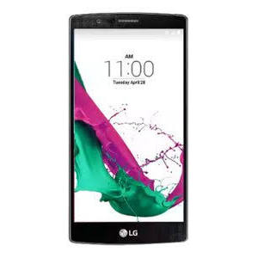
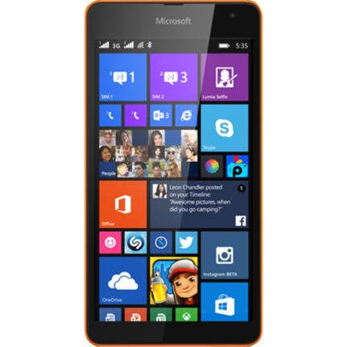
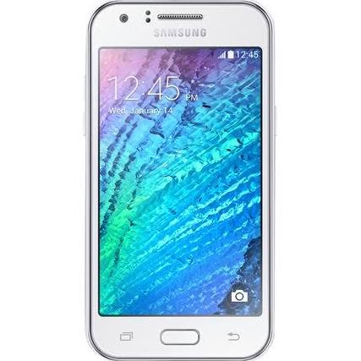
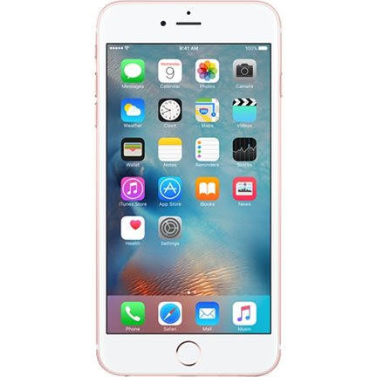
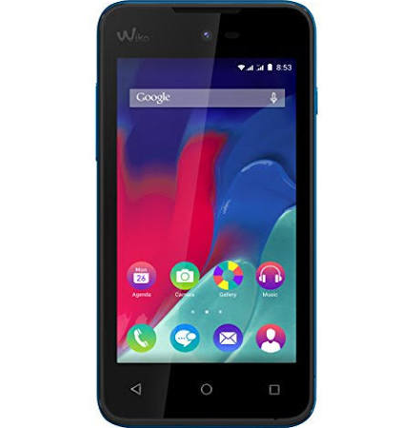
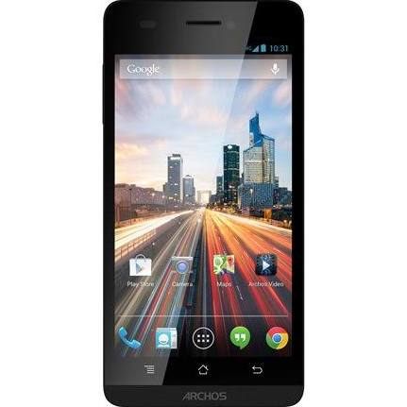
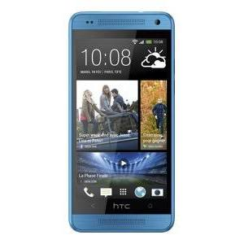
ECO-CONCEPTION
CYCLE DE VIE D’UN SMARTPHONE
FANG Ji
YANG Wenhui

Slide 2
SOMMAIRE
Contexte
Cycle de vie
Fin de vie
Conclusion
Bibliographie

Slide 3
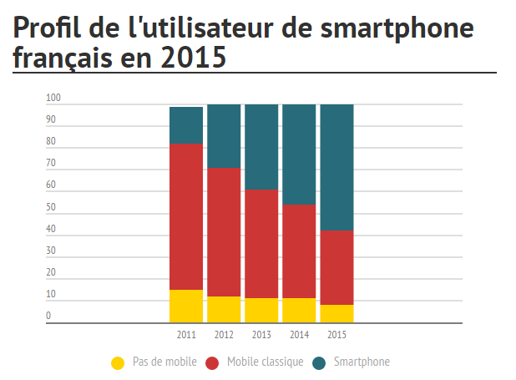
CONTEXTE
58% des Français sont équipés d'un smartphone en 2015

Slide 4
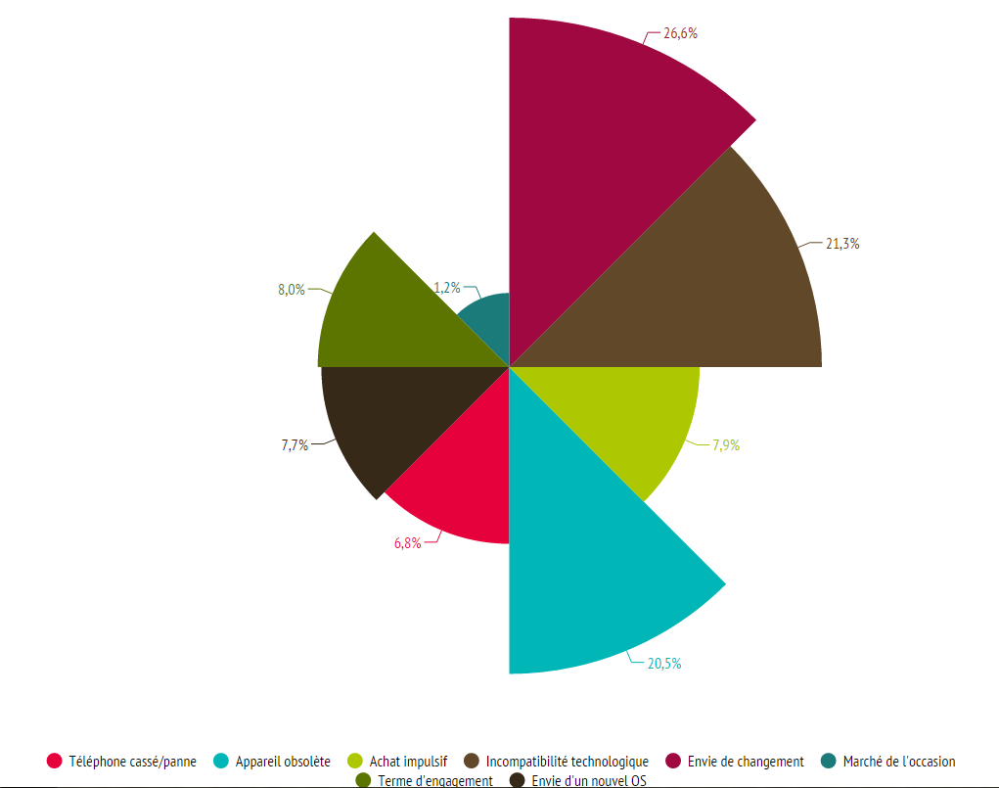
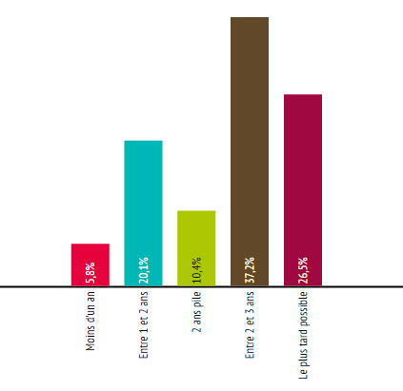
CONTEXTE
A quelle fréquence renouvelez- vous votre mobile?
Quels sont les motifs du changement?

Slide 5
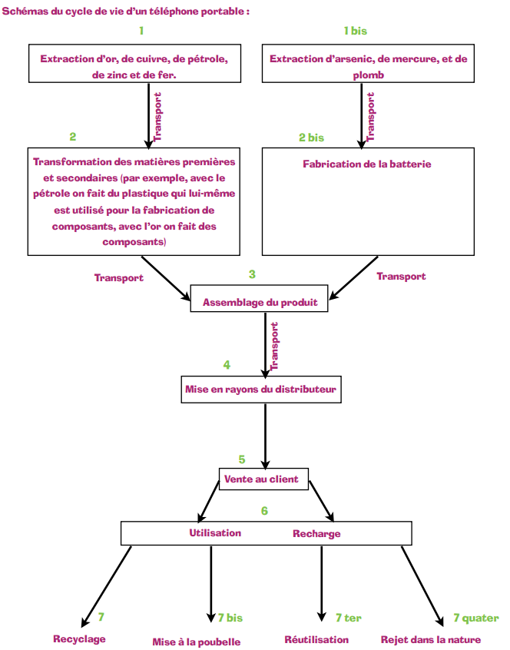
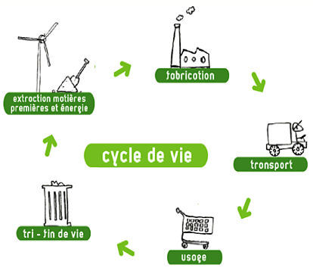
CYCLE DE VIE
Cycle de vie d’un smartphone

Slide 6
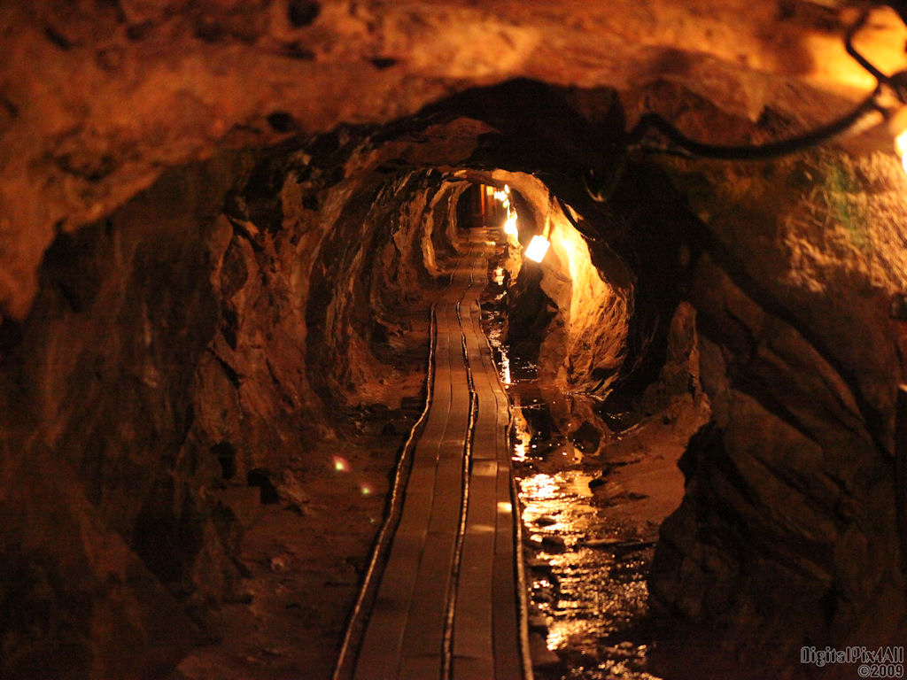
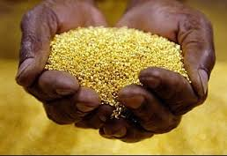
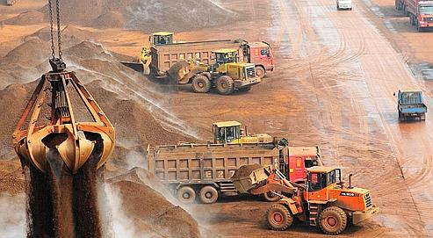
EXTRACTION
Or
Cuivre
Fer
Pétrole

Slide 7
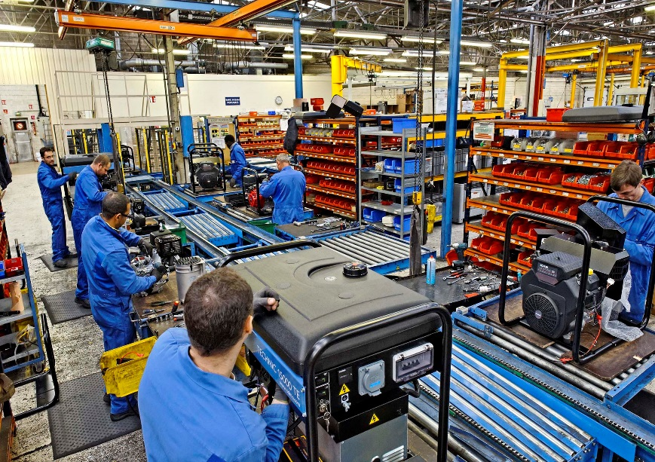
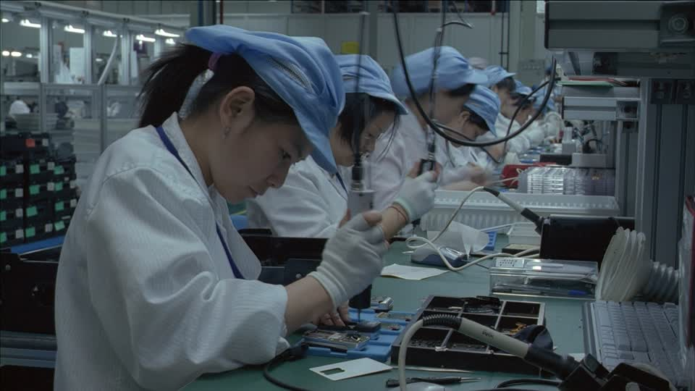
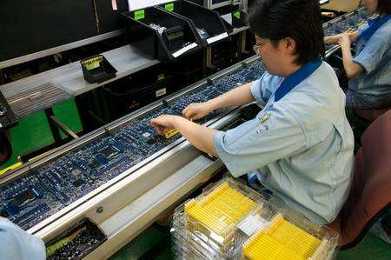
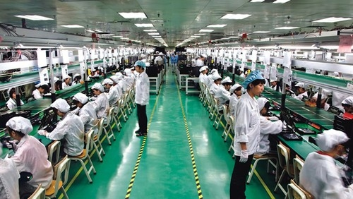
FABRICAITION ET ASSEMBLAGE

Slide 8
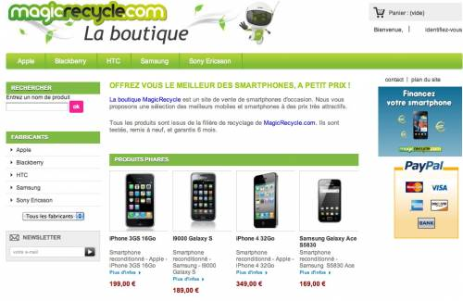
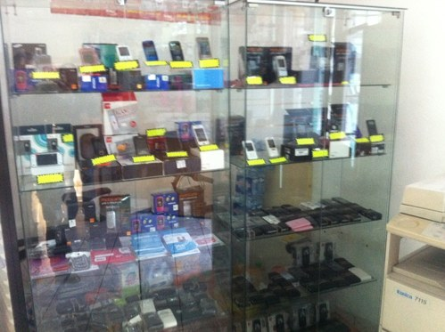
VENTE AU CLIENT
Vente de smartphone du monde

Slide 9
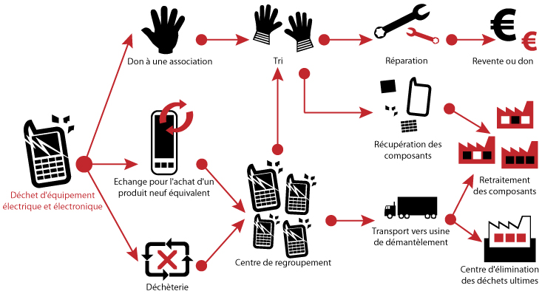
FIN DE VIE
Les traitements de fin de vie

Slide 10
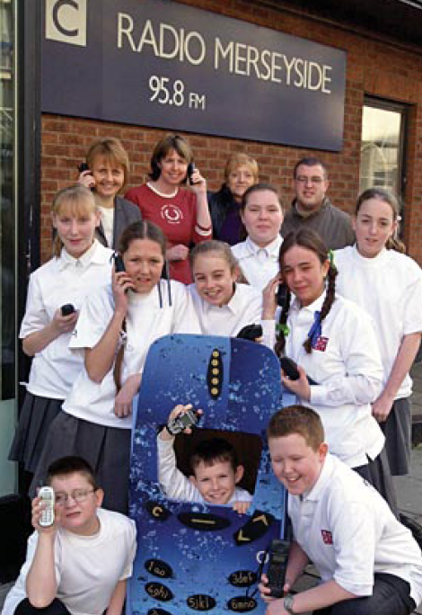
FIN DE VIE
Reusing mobile phones
Charity
Experience from network operators shows that one of the most important steps in establishing a successful take-back scheme is the incentives provided to customers. These vary depending on customers and cultural preferences but generally involve donations to charity, extra call minutes for the customer or a discount on a different phone.
Example: O2
For several years now, O2 has been running an annual fundraising activity with Fonebak and Radio Merseyside in the North West of England. The scheme encourages local schoolchildren to round up their families’ spare mobile phones for reuse in developing nations.
Several organisations in Gambia have benefited from the campaign, where the handsets bring real benefits to businesses such as women farmers associations.
Also, the funding are used to support charities in the North West of England, so everyone involved can see tangible benefits in their own communities.

Slide 11
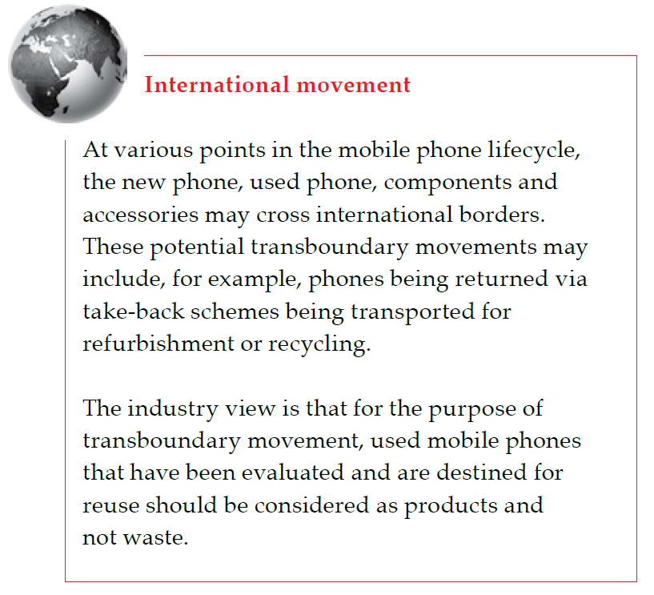
FIN DE VIE

Slide 12
FIN DE VIE
Importance of Recycle
Due to the evolution of technology and the tendency of consumers to want a device with more applications.
The average useful life of a mobile handset is around seven years, but users in developed countries replace their phones about every 18 months (in China it’s every 8-12 months).
In the UK alone, the industry estimates that around 15 million handsets go out of use each year.
Economy
Pollution

Slide 13
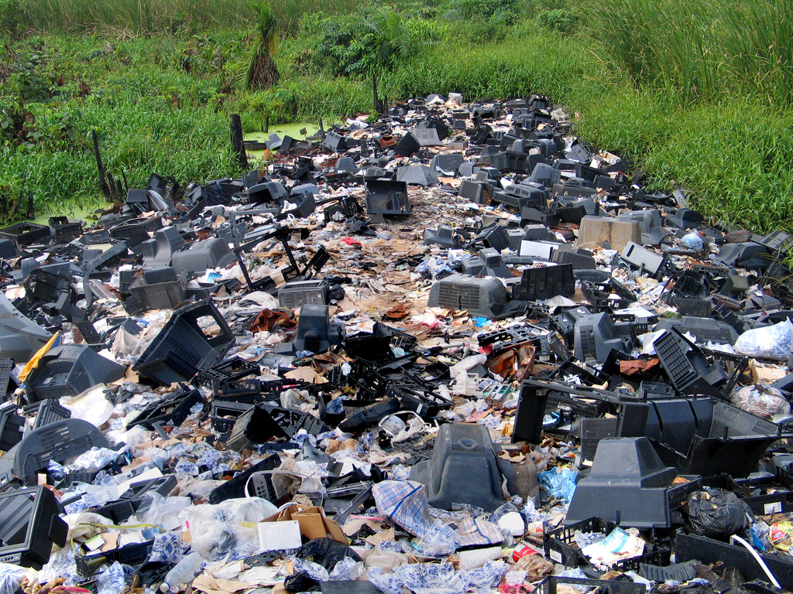
FIN DE VIE
Heavy metals like cadmium, beryllium, hexavalent chromium, or arsenic.
Can build up in our bodies and the environment.
Economy
Pollution

Slide 14
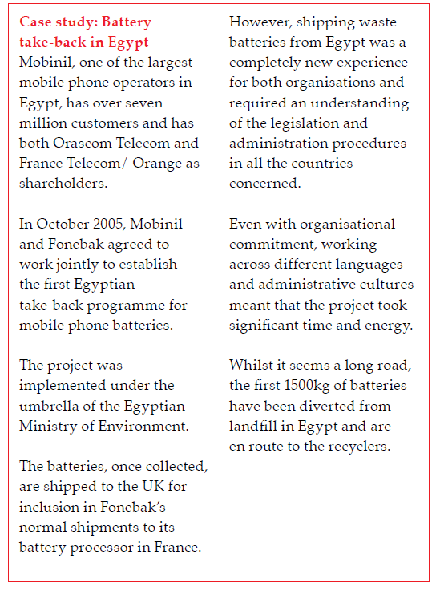
FIN DE VIE

Slide 15
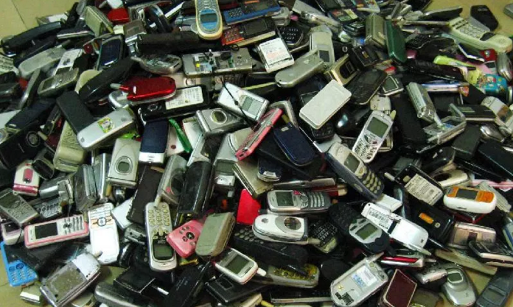
FIN DE VIE
China's mobile phone users are discarding 80 million devices annually
The recycling rate in the country stands at 9-10 percent of the global recycling average
The battery is toxic and has the capacity to pollute 15,850 gallons of water
Lack of company properly recycle the mobile devices, nor are there firms that provide services to separate the precious metals contained in the phones

Slide 16
FIN DE VIE
Refurbishment
These phones will then be subject to a series of tests to determine suitability for reuse with or without further repair.
Faulty parts will be replaced, batteries evaluated or exchanged and the phone’s appearance reconditioned.
Finally the refurbished phone will be packaged for resale along with a battery, charger, and instructions.
Any residual materials arising during the refurbishment
process are disposed of in an environmentally sound manner.

Slide 17
FIN DE VIE
Recycling end-of-life phones
The rest of the handset may be dismantled by manual and/or
mechanical separation of components or directly placed into high-temperature integrated metal smelters with efficient controls for the separation of metals and removal of waste gas.
The batteries are first separated from the mobile phone and sorted into their various types
Go for disposal (10 %)
Nickel cadmium, nickel metal hydride and lithium ion/polymer batteries have their metals recovered and reused in products such as power tools, saucepans and new batteries.
Gold, platinum, palladium and silver – are put back into productive use. About 16% (by weight) of a typical mobile phone is considered ‘high value’ materials.

Slide 18
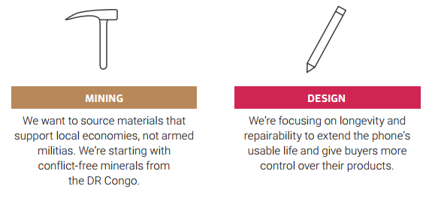
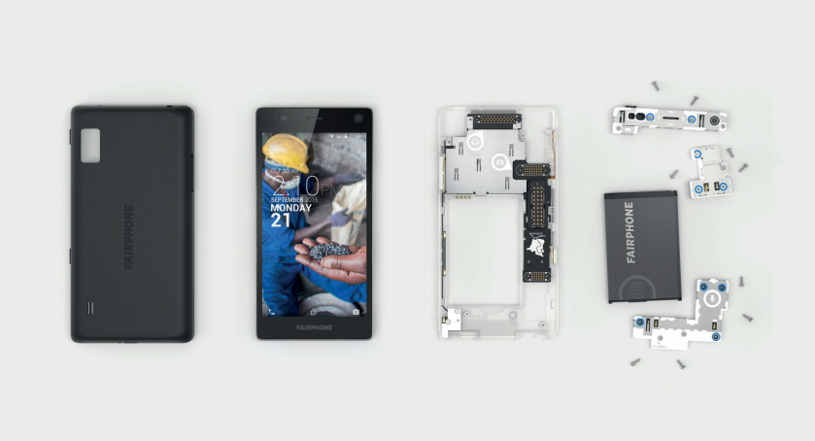
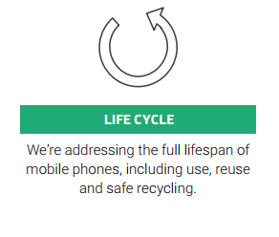
ECO SMARTPHONE

Slide 19
CONCLUSION
Aujourd’hui, plus en plus de gens ont les smartphone. Par conséquence, l’analyse de cycle de vie d’en portable particulièrement sur la fin de vie devient plus en plus important.
Il y a déjà eu plusieurs solutions pour traiter les smartphones qui ne fonctionnent plus.
Dans la condition réelle, les gens ne pas toujours respectent de traitements écologiques.
Écoconception de fabrication.

Slide 20
BIBLIOGRAPHIE
http://www.fredcavazza.net/2011/10/20/les-smartphones-sont-ils-en-fin-de-cycle-devolution/
http://multimedia.ademe.fr/outils/telephone-portable/Site-web/portable.pdf
http://www.conso.net/sites/default/files/images_publications/Animation6_Cycle_vie_telephone.pdf
http://www.zdnet.fr/actualites/infographie-portrait-de-l-utilisateur-de-smartphone-francais-39796286.htm
http://www.zdnet.fr/actualites/chiffres-cles-les-ventes-de-mobiles-et-de-smartphones-39789928.htm
http://www.cnetfrance.fr/news/le-difficile-recyclage-de-l-iphone-et-des-produits-electroniques-en-fin-de-vie-39783018.htm

Slide 21
MERCI

